Slide 1

Information and communication technologies
“the silent architects of a connected world”

Slide 2
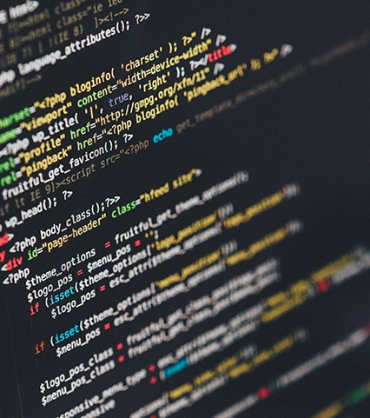

INTRODUCTION TO ICT
Overview & Backgrounds

Slide 3
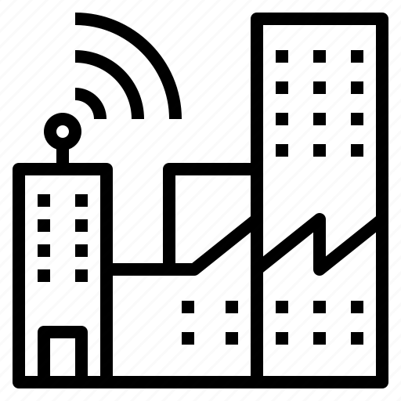
Definition
What is ICT ?
Information and Communication Technologies (ICT) represent a broad and dynamic field that encompasses the convergence of computing, telecommunications, and information systems. At its core, ICT involves the use of technology to manage and exchange information, enabling communication and interaction on various levels. The scope of ICT extends beyond traditional methods of information handling, incorporating a diverse range of hardware, software, networks, and applications.

Slide 4
Evolution and Development of ICT
The evolution of ICT is marked by significant milestones, reflecting the rapid advancements in technology over the decades. From the advent of mainframe computers to the proliferation of personal computing devices and the emergence of the internet, each phase has contributed to the expansion and sophistication of ICT.

Slide 5

Applications of ict
Business & Education

Slide 6

Applications of ict in business
Enhanced communication and collaboration
Streamlined operations and processes:
Improved customer service:
Data-driven decision making
E-commerce and online marketing
ICT tools like email, video conferencing, and instant messaging have made it easier for businesses to communicate with employees, customers, and partners in real-time, regardless of location. This has improved collaboration, boosted productivity, and facilitated faster decision-making.
ICT has enabled businesses to automate many tasks, from accounting and payroll to customer service and inventory management. This has freed up employees to focus on more strategic work, improved efficiency, and reduced costs.
Businesses can now use ICT to provide better customer service through online chat, self-service portals, and social media. This allows them to resolve customer issues quickly and efficiently, build stronger relationships, and improve customer satisfaction.
ICT has given businesses access to vast amounts of data, which they can use to gain insights into their customers, operations, and markets. This data can be used to make informed decisions about everything from product development and marketing to pricing and strategic planning.
ICT has made it possible for businesses to sell their products and services online, reaching a wider audience than ever before. Online marketing channels like search engine optimization (SEO) and social media marketing can be used to attract new customers and generate leads.

Slide 7

Applications of ict in Education
Enhanced learning experiences
Improved communication and collaboration
Personalized learning
Distance learning
ICT can be used to create engaging and interactive learning experiences that cater to different learning styles. It can provide students with access to a wealth of information and resources, and it can help them develop critical thinking, problem-solving, and collaboration skills.
ICT has made it possible for students to learn from anywhere in the world, regardless of location or time constraints. This is particularly beneficial for students in remote areas or those who have difficulty attending traditional classroom settings.
ICT tools can be used to improve communication and collaboration between students, teachers, and parents. This can help to create a more supportive learning environment and foster a sense of community.
ICT can be used to personalize learning by tailoring instruction to individual student needs and strengths. This can help students learn at their own pace and achieve their full potential.

Slide 8

THE FUTURE OF ICT
Where is it going?

Slide 9
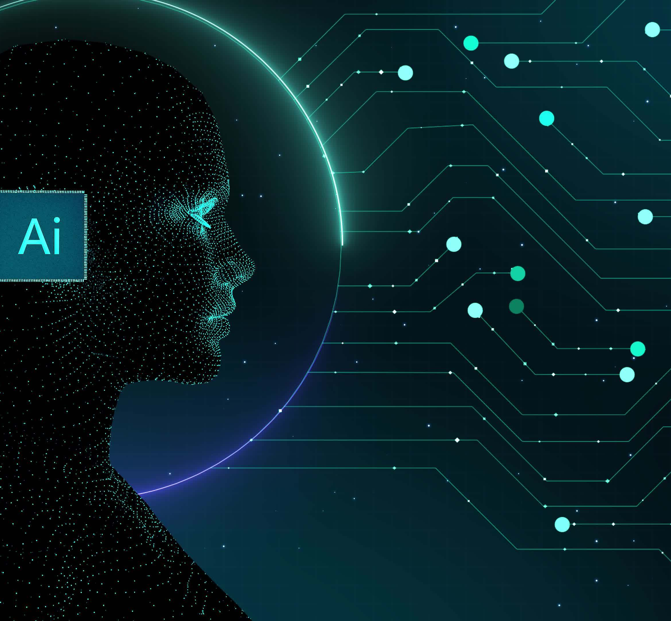
Artificial Intelligence (AI):
AI is rapidly transforming various industries, and its integration into ICT will be even more prevalent in the future. Expect to see AI-powered applications like:
Smarter and more personalized user interfaces: AI-powered Chatbots and virtual assistants will become even more sophisticated, providing us with intuitive and personalized experiences across devices
Intelligent automation: AI will automate even more complex tasks, freeing up human time and resources for creative and strategic endeavors.

Slide 10
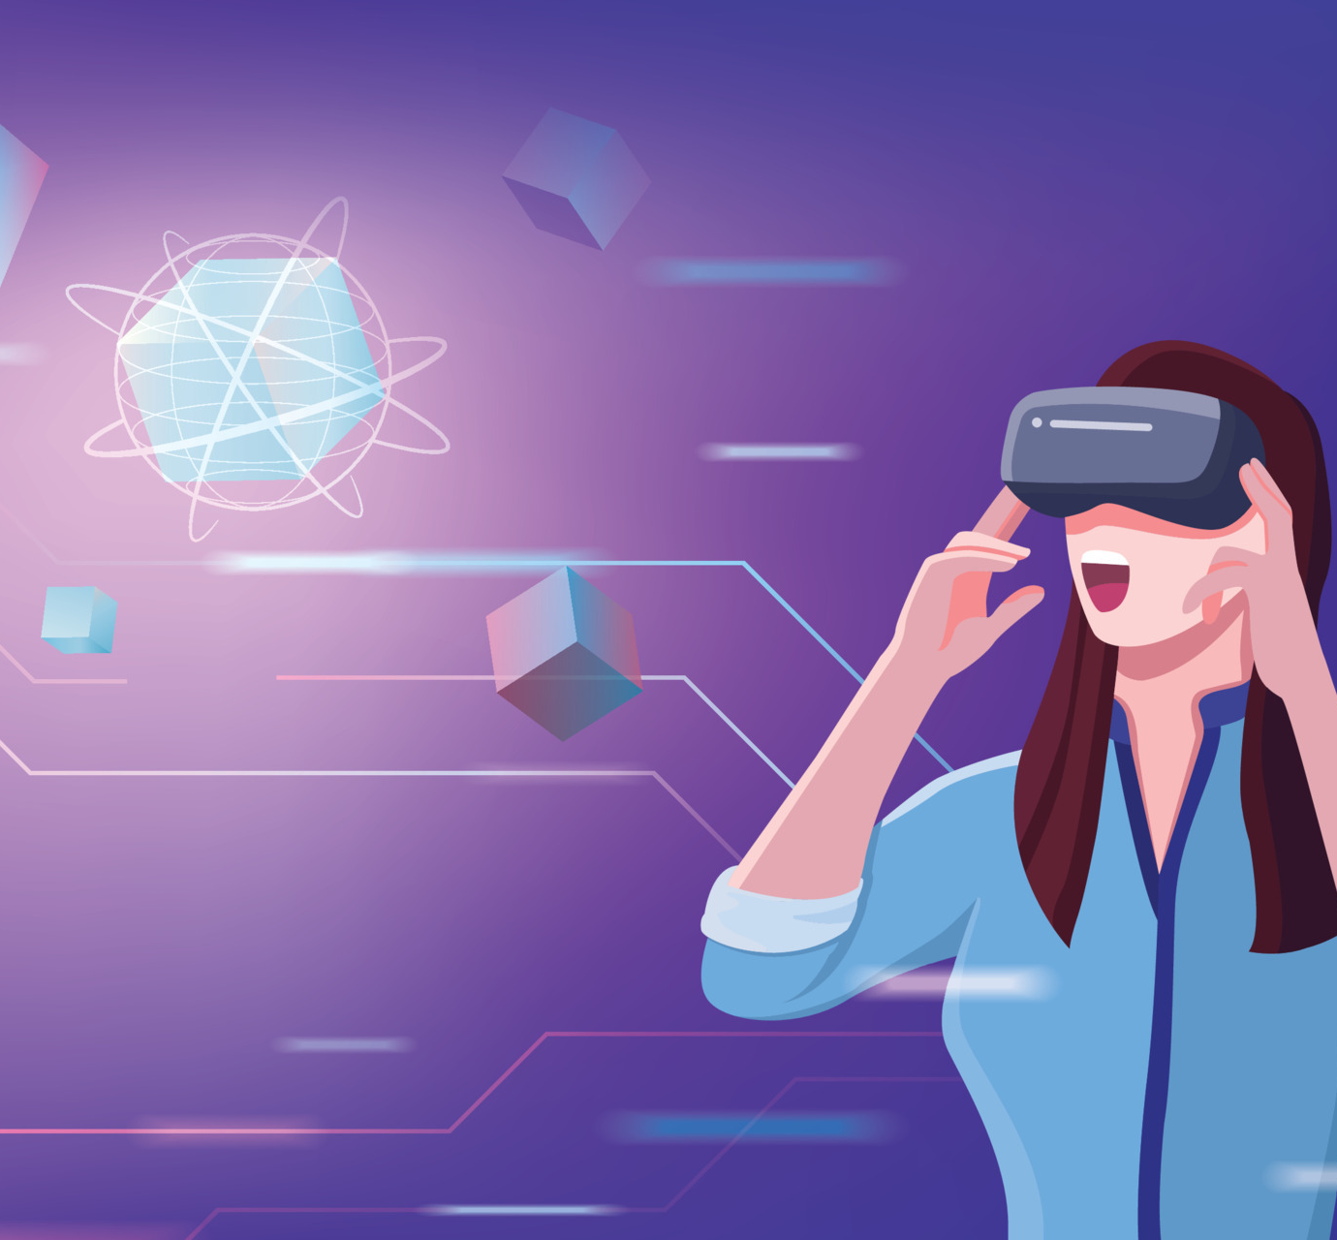
AUGMENTED AND VIRTUAL REALITY (VR/AR):
The lines between the physical and digital worlds will blur further with advancements in AR and VR, impacting:
Entertainment and gaming: VR will create hyper-realistic gaming experiences and push the boundaries of storytelling and entertainment, transporting us to entirely new worlds.
Enhanced learning and education: Imagine immersive virtual classrooms or AR overlays that provide instant information about physical objects, revolutionizing the way we learn and interact with knowledge.

Slide 11

TECHNOLOGIES RELATED TO ICT
Might be helpful to know!

Slide 12






Google and Microsoft
Google services such as :
2. Microsoft services such as
Gmail
Microsoft Word
Docs
Drive
Microsoft Excel
Microsoft PowerPoint

Slide 13




GIT & GITHUB
Git is a fundamental aspect of collaborative software development that serves as a distributed version control system (DVCS) that plays a pivotal role in tracking changes efficiently.
GitHub, built around Git, is a web-based platform that significantly enhances collaborative software development. It acts as a centralized hub for version-controlled code repositories, providing tools for collaboration, code review, and issue tracking.

Slide 14

Final conclusion
Last but not least

Slide 15
At the end
The future of information and communication technologies (ICT) is a kaleidoscope of possibilities, brimming with transformative potential for individuals, businesses, and society as a whole. From AI-powered automation to hyper-connected cities and immersive virtual worlds, the coming years promise a revolution in how we live, work, and learn. However, this exciting future comes with a responsibility to navigate its implications thoughtfully and ethically

Slide 16

Thank you
GROUPE 12

